Slide 1
Maximum Entropy Markov Models
CS 162: Natural Language Processing
Nanyun (Violet) Peng
Course website: https://vnpeng.net/cs162_win24.html
syllabus,
announcements,
slides,
homeworks
1

Slide 2
Outline
Leftover from HMM: Learning HMM
Introduction to Maximum Entropy Markov Model (MEMM)
Training of MEMM
Inference for MEMM
Comparisons between HMM and MEMM

Slide 3
Leftovers: Learning HMM

Slide 4
Learning HMM parameters
Assume we know the number of states in the HMM
Two possible scenarios
We are given a data set D = {<x_{i}, y_{i}>} of sequences labeled with states
And we have to learn the parameters of the HMM (π, A, B)
We are given only a collection of sequences D = {x_{i}}
And we have to learn the parameters of the HMM (π, A, B)
Supervised learning with complete observation
Unsupervised learning, with incomplete observation

Slide 5
Supervised learning of HMM
We are given a dataset D = {<x_{i}, y_{i}>}
Each x_{i} is a sequence of observations and y_{i} is a sequence of states that correspond to x_{i}
Goal: Learn initial, transition, emission distributions (π, A, B)
How do we learn the parameters of the probability distribution?
The maximum likelihood principle
Where have we seen this before?

Slide 6
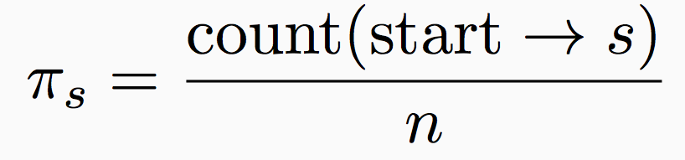
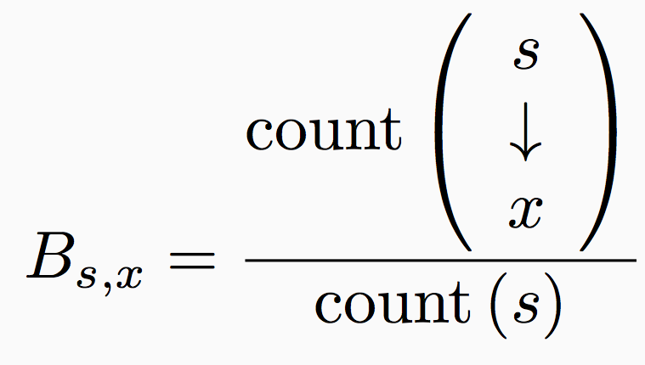
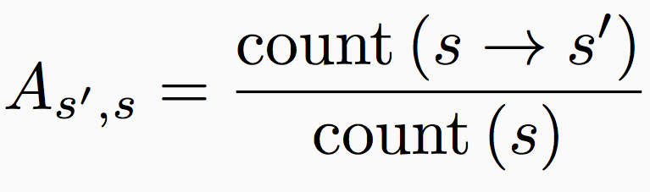
Supervised learning details
π, A, B can be estimated separately just by count and devide!
Makes learning simple and fast
Number of instances where the first state is s
Number of examples
Number of times that state s emits observation x
Initial probabilities
Number of times that state s transits to state s’
Transition probabilities
Emission probabilities
Number of times that state s appears
Number of times that state s appears

Slide 7
Maximum Entropy Markov Model

Slide 8
Modeling the state probability directly
Instead of modeling the joint distribution P(x, y) only focus on P(y|x)
Which is what we care about most of the time.
Does this look familiar?
For sequences, different formulations
Maximum Entropy Markov Model [McCallum, et al 2000]
Conditional Random Fields [Lafferty, 2001]

Slide 9
Generative vs Discriminative models
Generative models
learn P(x, y)
Characterize how the data is generated (both inputs and outputs)
Eg: Naïve Bayes, Hidden Markov Model
Discriminative models
learn P(y | x)
Directly characterizes the decision boundary only
Eg: Logistic Regression, Maximum Entropy Markov Model, Conditional Random Fields

Slide 10
Generative vs Discriminative Models
Generative models
learn P(x, y)
Characterize how the data is generated (both inputs and outputs)
Eg: Naïve Bayes, Hidden Markov Model
Discriminative models
learn P(y | x)
Directly characterizes the decision boundary only
Eg: Logistic Regression, Maximum Entropy Markov Model, Conditional Random Fields
A generative model tries to characterize the distribution of the inputs, a discriminative model doesn’t care

Slide 11

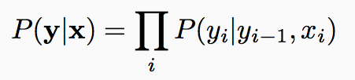
A Discriminative Model
This assumption lets us write the conditional probability of the output as
y_{t-1}
y_{t}
y_{t-1}
y_{t}
HMM
Conditional
model
x_{t}
x_{t}

Slide 12
Maximum Entropy Markov Model
Goal: Compute P(y | x)
start
Determiner
Noun
Verb
Noun
Noun
The
Fed
raises
interest
rates
The prediction task: Using the entire input and the previous label, predict the current label

Slide 13
Training for MEMM

Slide 14
Decomposition Based on Markov Assumption
This assumption lets us write the conditional probability of the output as
y_{t-1}
y_{t}
y_{t-1}
y_{t}
HMM
Conditional
model
x_{t}
x_{t}
We need to learn this function

Slide 15
Modeling P(y_{i} | y_{i-1}, x_{i})
Different approaches possible
Train a log-linear model
Or, ignore the fact that we are predicting a probability, we only care about maximizing some score. Train any classifier (e.g, perceptron algorithm)
For both cases:
Use rich features that depend on input and previous state
We can increase the dependency to arbitrary neighboring x_{i}’s
Eg. Neighboring words influence this words POS tag

Slide 16
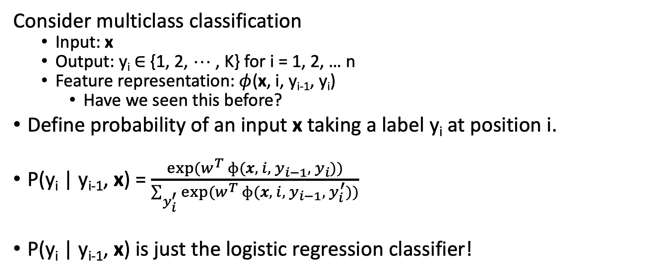
Log-linear models
Consider multiclass classification
Input: x
Output: y_{i} $∈$ {1, 2, ☹ , K} for i = 1, 2, … n
Feature representation: $φ$(x, i, y_{i-1}, y_{i})
Have we seen this before?
Define probability of an input x taking a label y_{i} at position i.
P(y_{i} | y_{i-1}, x) = $\frac{exp⁡(w^{T} ɸ(x, { i, y}_{i−1},{ y}_{i}))}{\sum_{y_{i}^{′}}{exp⁡(w^{T}} ɸ(x, { i, y}_{i−1},{ y}_{i}^{′}))}$
P(y_{i} | y_{i-1}, x) is just the logistic regression classifier!
Interpretation: Score for label, converted to a well-formed probability distribution by the softmax function. ☺

Slide 17
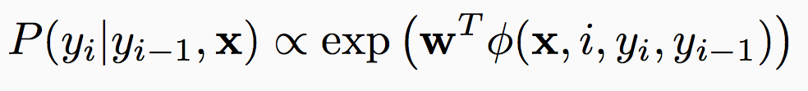
Maximum Entropy Markov Model
Goal: Compute
start
Determiner
Noun
Verb
Noun
Noun
The
Fed
raises
interest
rates
word
Caps
To model the probability, first, we need to define features for the current classification problem
-es
Previous

Slide 18
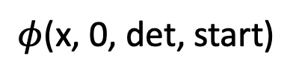
Maximum Entropy Markov Model
Goal: Compute P(y | x)
start
Determiner
Noun
Verb
Noun
Noun
The
Fed
raises
interest
rates
word
The
Caps
Y
-es
N
Previous
start
$φ$(x, 0, det, start)

Slide 19





Maximum Entropy Markov Model
Goal: Compute P(y | x)
start
Determiner
Noun
Verb
Noun
Noun
The
Fed
raises
interest
rates
word
The
Fed
raises
interest
rates
Caps
Y
Y
N
N
N
Can get very creative here
-es
N
N
Y
N
Y
Previous
start
Determiner
Noun
Verb
Noun
$ϕ$(x, 0, y₁, y₀)
$ϕ$(x, 1, y_{2,} y₁)
$ϕ$(x, 2, y₃, y₂)
$ϕ$(x, 3, y₄, y₃)
$ϕ$(x, 4, y₅, y₄)

Slide 20
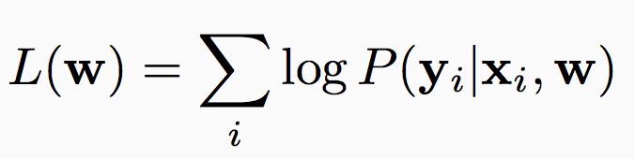
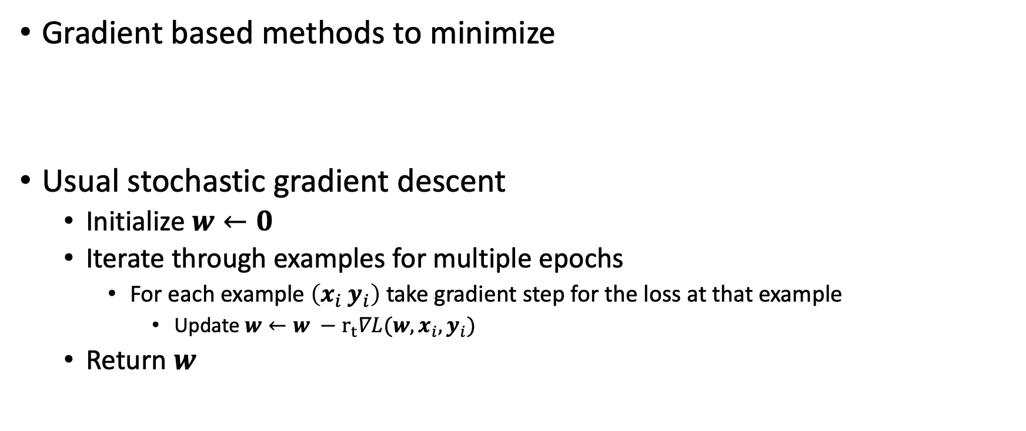
Training a log-linear model
Gradient based methods to minimize
Usual stochastic gradient descent
Initialize $w←0$
Iterate through examples for multiple epochs
For each example $\left(x_{i} y_{i}\right)$ take gradient step for the loss at that example
Update $w←w −r_{t}∇L(w, x_{i}, y_{i})$
Return $w$

Slide 21
Inference for MEMM

Slide 22
Greedy Decoding for MEMM?
Comparing sequence labeling with classification for the two examples
The
robot
wheels
are
round
The
robot
wheels
Bill
round
0.7
0.9
0.6
0.7
0.2
0.6
N
V
A
N
V
A
D
1
N
D
N
V
N
N
V
N
N
0.3
0.1
0.4
0.3
0.8
0.4
Notes:
If take individual classification approach, the best sequence for the two sentences would be:
With sequence labeling, it would be:
Why?
This also shows why the inference problem is non-trivial.

Slide 23
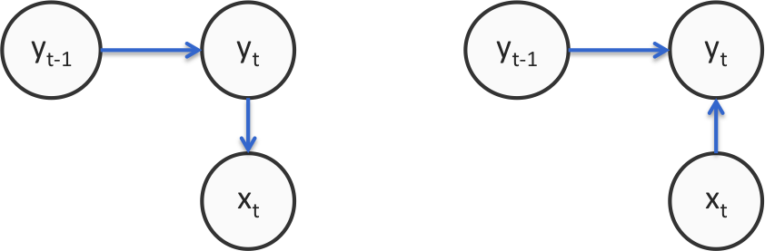
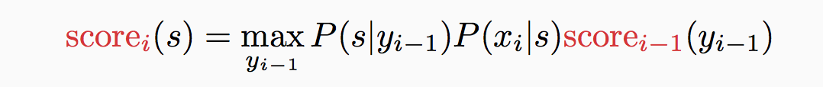
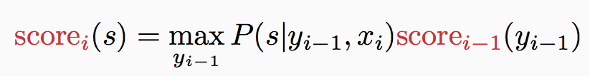
Inference MEMM
Prediction/decoding
The same Viterbi algorithm as HMM with the new independence assumptions (scoring functions) --- only need to slightly change the recursion.
HMM
Conditional Markov model
Notes:
Why cannot we do greedy decoding? Wheels are round vs. wheels Bob round

Slide 24
Comparison to HMM
What we gain
Rich feature representation for inputs
Helps generalize better by thinking about properties of the input words rather than each entire word
Eg: If a word ends with –es, it might be a present tense verb (such as raises), or plural noun (e.g., boxes). Could make a feature; HMM cannot capture this
Discriminative predictor
Model P(y | x) rather than P(y, x)
Conditional vs. Joint

Slide 25
HMM vs. MEMM
Both: Decomposition of total probability with tractable cliques.
Hidden Markov models
Pros: can do unsupervised training.
Cons: Doesn’t allow use of features for representing inputs
Maximum Entropy Markov Models
Pros: Conditional model, allows features to be used
Cons: Do not support unsupervised training, Label bias problem

Slide 26
Next
Introduction to Information Extraction
Named Entity Recognition
Neural Sequence Tagging Models

